Slide 1
EC3357:Machine Learning
Lecture 7: Unsupervised Learning

Slide 2
What is Unsupervised Learning?
In some pattern recognition problems, the training data consists of a set of input vectors x without any corresponding target values. The goal in such unsupervised learning problems may be to discover groups of similar examples within the data.
Unsupervised Learning is a machine learning technique in which the users do not need to supervise the model. Instead, it allows the model to work on its own to discover patterns and information that was previously undetected. It mainly deals with the unlabeled data.
Unsupervised Learning Algorithms allow users to perform more complex processing tasks compared to supervised learning

Slide 3
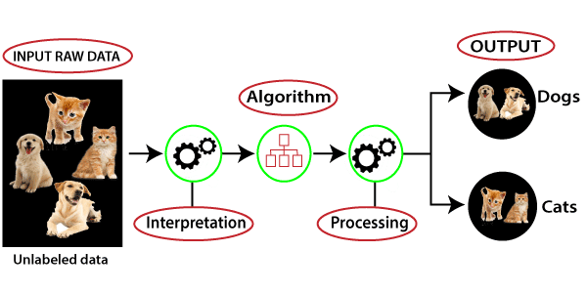
What Is Unsupervised Learning?

Slide 4
Common unsupervised learning approaches
Unsupervised learning models are utilized for three main tasks
clustering,
association, and
dimensionality reduction.

Slide 5
Clustering
Clustering is a data mining technique which groups unlabeled data based on their similarities or differences.
Clustering algorithms are used to process raw, unclassified data objects into groups represented by structures or patterns in the information.
Clustering algorithms can be categorized into a few types, specifically:
exclusive,
overlapping,
hierarchical, and
probabilistic.

Slide 6
Exclusive and Overlapping Clustering
Exclusive clustering is a form of grouping that stipulates a data point can exist only in one cluster. There is no overlap between clusters, and each data point is assigned to the cluster with which it shares the highest similarity. This can also be referred to as “hard” clustering. The K-means clustering and hierarchical clustering algorithms are examples of exclusive clustering.
Overlapping clusters (also known as soft clustering and fuzzy clustering) differs from exclusive clustering in that it allows data points to belong to multiple clusters with separate degrees of membership. Fuzzy C-Means (FCM) and Gaussian Mixture Models (GMM) are examples of overlapping clustering.

Slide 7
Hierarchical clustering
Hierarchical clustering, also known as hierarchical cluster analysis (HCA), is an unsupervised clustering algorithm that can be categorized in two ways; they can be agglomerative or divisive.
Agglomerative clustering is considered a “bottoms-up approach.” Its data points are isolated as separate groupings initially, and then they are merged together iteratively on the basis of similarity until one cluster has been achieved.
The inverse of agglomerative clustering is divisive clustering, which is also known as DIANA (Divise Analysis) and it works in a “top-down” manner. It begins with the root, in which all objects are included in a single cluster. At each step of iteration, the most heterogeneous cluster is divided into two. The process is iterated until all objects are in their own cluster.

Slide 8
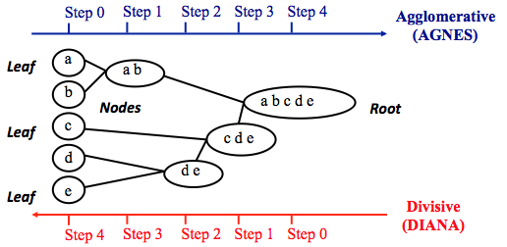

Slide 9
Probabilistic clustering
Probabilistic clustering is a type of clustering that assigns data points to clusters based on probabilities. Rather than assigning each point to a single cluster (as in exclusive clustering) or allowing membership in multiple clusters with degrees (as in fuzzy clustering), probabilistic clustering uses statistical methods to model the likelihood that each data point belongs to each cluster.

Slide 10
Association Rules
An association rule is a rule-based method for finding relationships between variables in a given dataset. These methods are frequently used for market basket analysis, allowing companies to better understand relationships between different products.

Slide 11
Dimensionality reduction
While more data generally yields more accurate results, it can also impact the performance of machine learning algorithms (e.g. overfitting) and it can also make it difficult to visualize datasets.
Dimensionality reduction is a technique used when the number of features, or dimensions, in a given dataset is too high. It reduces the number of data inputs to a manageable size while also preserving the integrity of the dataset as much as possible.
It is commonly used in the preprocessing data stage, and there are a few different dimensionality reduction methods that can be used, such as:
Principal component analysis
Singular value decomposition
Autoencoders

Slide 12
Clustering
Clustering can be considered the most important unsupervised learning problem; so, as every other problem of this kind, it deals with finding a structure in a collection of unlabeled data.
A loose definition of clustering could be “the process of organizing objects into groups whose members are similar in some way”.
A cluster is therefore a collection of objects which are “similar” between them and are “dissimilar” to the objects belonging to other clusters.
It groups data instances that are similar to (near) each other in one cluster and data instances that are very different (far away) from each other into different clusters.

Slide 13
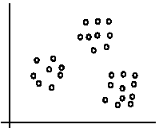
An illustration
The data set has three natural groups of data points, i.e., 3 natural clusters.

Slide 14
What is clustering for?
Let us see some real-life examples
Example 1: groups people of similar sizes together to make “small”, “medium” and “large” T-Shirts.
Example 2: In marketing, segment customers according to their similarities
Example 3: Given a collection of text documents, we want to organize them according to their content similarities,

Slide 15
Distance metrics (distance measures)
Quantify the similarity or dissimilarity between two data points in a dataset based on their feature values.
These metrics are fundamental for algorithms like K-Means, hierarchical clustering, and density-based clustering, as they help group similar data points together.
Here are some commonly used distance metrics in the context of clustering:
Euclidean Distance:
Manhattan Distance (City Block Distance)
Cosine Similarity

Slide 16
Distance-based clustering.
Given a set of points, with a notion of distance between points, grouping the points into some number of clusters, such that
internal (within the cluster) distances should be small i.e members of clusters are close/similar to each other.
external (intra-cluster) distances should be large i.e. members of different clusters are dissimilar.
Clustering quality
Inter-clusters distance ⇒ maximized
Intra-clusters distance ⇒ minimized
The quality of a clustering result depends on the algorithm, the distance function, and the application.

Slide 17

Proximity Measures
For clustering, we need to define a proximity measure for two data points. Proximity here means how similar/dissimilar the samples are with respect to each other.
Similarity measure S(xi,xk): large if xi,xk are similar
Dissimilarity(or distance) measure D(xi,xk): small if xi,xk are similar
There are various similarity measures which can be used:
Vectors: Cosine Distance
Sets: Jaccard Distance
Points: Euclidean Distance

Slide 18
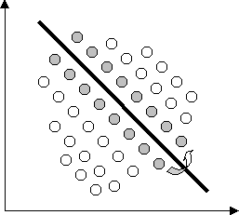
Exclusive Clustering
In exclusive clustering, data are grouped in an exclusive way, so that if a certain data point belongs to a definite cluster then it could not be included in another cluster. A simple example of that is shown in the figure below, where the separation of points is achieved by a straight line on a bi-dimensional plane.

Slide 19
K-Means Clustering
K-means is an exclusive clustering algorithm
The procedure follows a simple and easy way to classify a given data set through a certain number of clusters (assume k clusters) fixed a priori.
The main idea is to define k centres, one for each cluster. These centroids should be placed in a smart way because of different location causes different result. So, the better choice is to place them as much as possible far away from each other.
The next step is to take each point belonging to a given data set and associate it to the nearest centroid. When no point is pending, the first step is completed and an early groupage is done.

Slide 20
K-Means Algorithm
Step-1: Select the number K to decide the number of clusters.
Step-2: Select random K points or centroids. (It can be other from the input dataset).
Step-3: Assign each data point to their closest centroid, which will form the predefined K clusters.
Step-4: Calculate the variance and place a new centroid of each cluster.
Step-5: Repeat the third steps, which means reassign each datapoint to the new closest centroid of each cluster.
Step-6: If any reassignment occurs, then go to step-4 else go to FINISH.
Step-7: The model is ready.

Slide 21
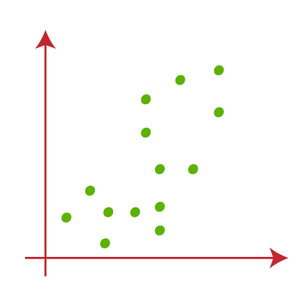
Suppose we have two variables M1 and M2. The x-y axis scatter plot of these two variables is given below:

Slide 22
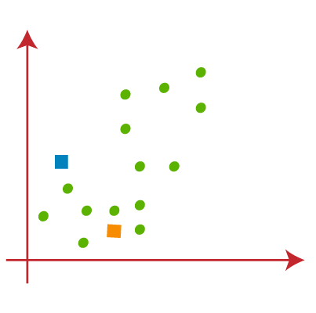
Let's take number k of clusters, i.e., K=2, to identify the dataset and to put them into different clusters. It means here we will try to group these datasets into two different clusters.
We need to choose some random k points or centroid to form the cluster. These points can be either the points from the dataset or any other point. So, here we are selecting the below two points as k points, which are not the part of our dataset. Consider the below image:

Slide 23
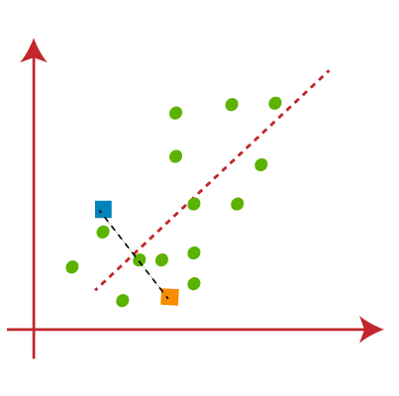
Now we will assign each data point of the scatter plot to its closest K-point or centroid. We will compute it by applying some mathematics to calculate the distance between two points. So, we will draw a median between both the centroids. Consider the below image:
From the above image, it is clear that points left side of the line is near to the K1 or blue centroid, and points to the right of the line are close to the yellow centroid. Let's color them as blue and yellow for clear visualization.

Slide 24
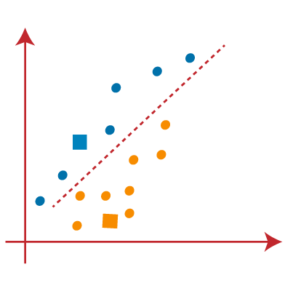

Slide 25
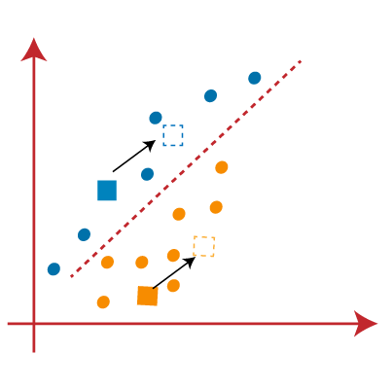
As we need to find the closest cluster, so we will repeat the process by choosing a new centroid. To choose the new centroids, we will compute the center of gravity of these centroids, and will find new centroids as below:

Slide 26
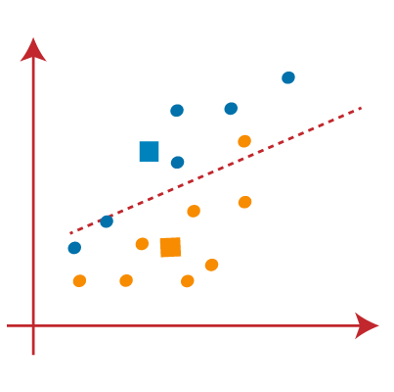
Next, we will reassign each datapoint to the new centroid. For this, we will repeat the same process of finding a median line. The median will be like below image:

Slide 27
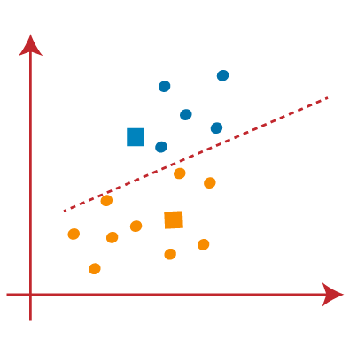
From the above image, we can see, one yellow point is on the left side of the line, and two blue points are right to the line. So, these three points will be assigned to new centroids.

Slide 28
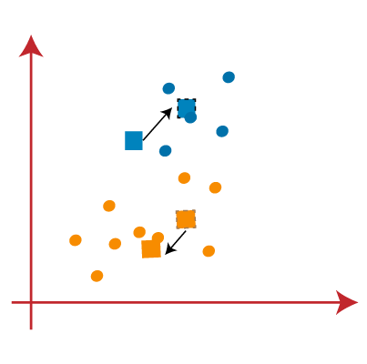
As reassignment has taken place, so we will again go to the step-4, which is finding new centroids or K-points.
We will repeat the process by finding the center of gravity of centroids, so the new centroids will be as shown in the below image:

Slide 29
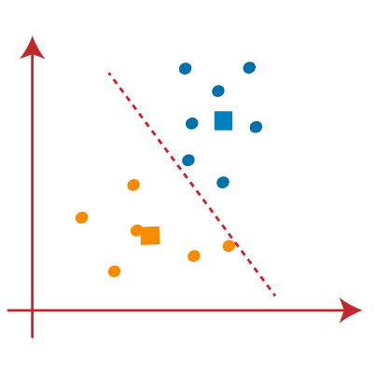
As we got the new centroids so again will draw the median line and reassign the data points. So, the image will be:

Slide 30
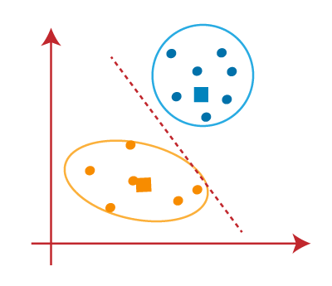
We can see in the above image; there are no dissimilar data points on either side of the line, which means our model is formed. Consider the below image:

Slide 31

As our model is ready, so we can now remove the assumed centroids, and the two final clusters will be as shown in the below image:

Slide 32
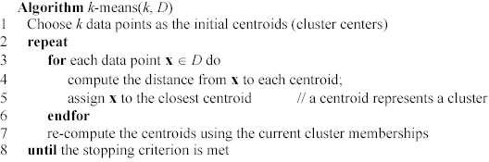
K-means algorithm – (cont …)

Slide 33
Stopping/convergence criterion
no (or minimum) re-assignments of data points to different clusters,
no (or minimum) change of centroids, or
minimum decrease in the sum of squared error (SSE),
C_{i} is the jth cluster, m_{j} is the centroid of cluster C_{j} (the mean vector of all the data points in C_{j}), and dist(x, m_{j}) is the distance between data point x and centroid m_{j}.
(1)

Slide 34
Some issues with K-means algorithm
Although it can be proved that the procedure will always terminate, the k-means algorithm does not necessarily find the most optimal configuration, corresponding to the global objective function minimum. The algorithm is also significantly sensitive to the initial randomly selected cluster centres. The k-means algorithm can be run multiple times to reduce this effect.
The performance of the K-means clustering algorithm depends upon highly efficient clusters that it forms. But choosing the optimal number of clusters is a big task. There are some different ways to find the optimal number of clusters.
The algorithm is sensitive to outliers

Slide 35
Weaknesses of k-means: To deal with outliers
One method is to remove some data points in the clustering process that are much further away from the centroids than other data points.
To be safe, we may want to monitor these possible outliers over a few iterations and then decide to remove them.
Another method is to perform random sampling. Since in sampling we only choose a small subset of the data points, the chance of selecting an outlier is very small.
Assign the rest of the data points to the clusters by distance or similarity comparison, or classification

Slide 36
K-means summary
Despite weaknesses, k-means is still the most popular algorithm due to its simplicity, efficiency and
other clustering algorithms have their own lists of weaknesses.
No clear evidence that any other clustering algorithm performs better in general
although they may be more suitable for some specific types of data or applications.
Comparing different clustering algorithms is a difficult task. No one knows the correct clusters!

Slide 37
Why is Unsupervised Learning needed?
Annotating large datasets is very costly and hence we can label only a few examples manually. Example: Speech Recognition
There may be cases where we don’t know how many/what classes is the data divided into. Example: Data Mining
We may want to use clustering to gain some insight into the structure of the data before designing a classifier.

Slide 38
Challenges of unsupervised learning
While unsupervised learning has many benefits, some challenges can occur when it allows machine learning models to execute without any human intervention. Some of these challenges can include:
Computational complexity due to a high volume of training data
Longer training times
Higher risk of inaccurate results
Human intervention to validate output variables
Lack of transparency into the basis on which data was clustered

Slide 39
Sample Program
https://domino.ai/blog/getting-started-with-k-means-clustering-in-python
https://towardsdatascience.com/understanding-k-means-clustering-in-machine-learning-6a6e67336aa1
https://www.geeksforgeeks.org/k-means-clustering-introduction/
Try the 3rd one.

